Slide 1

Collections Executive Council
Opryland Hotel
Nashville, Tennessee

Slide 2

Introductions
Share the following:
  Your name
  Company
  Current role
  History in industry

Slide 3


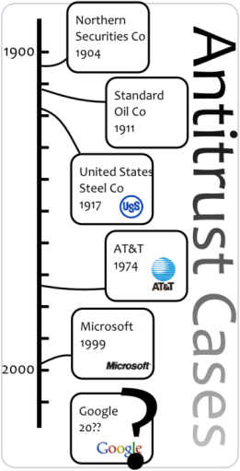
Housekeeping items
Restrooms
Cell phones / Blackberries
Anti-trust agreement

Slide 4

Experian update
and market view
Name
© 20## Experian Information Solutions, Inc. All rights reserved.
Experian Public.
4

Slide 5

Agenda
Experian update
Market trends
Insights
  Prospecting
  Originations
  Portfolio management
  Collections

Slide 6
Overview
Global revenue FY11
By geography
By business line
Continent
Service
Service
Continent
Continent
Service
Continent
Service
By customer segment
Customer
Customer
Diverse portfolio
by geography, business line, and customer segment
Customer
Customer
Customer
Customer
Customer
Customer
Revenue for the year
Customer

Slide 7

Strategic overview
Our global strategic objectives
Extend our global lead in credit information and analytics
Create successful businesses in new customer segments
Build large-scale operations in major emerging
consumer economies
Become the global leader in digital marketing services
Become the most trusted consumer brand for credit
information and identity protection services

Slide 8




Strategic overview
New bureau expansion
Majority stake in joint venture with six leading banks, subject to regulatory approval
Intention to launch a credit bureau
Fourth largest economy
Approximately XX million credit active individuals
Positive data legislation pending
Experian has a long track record, with critical mass

Slide 9

Market view
© 20## Experian Information Solutions, Inc. All rights reserved.
Experian Public.
9

Slide 10
Credit prospecting
Consumer score distribution changes
“A” category
decreased
“F” category
decreased
2010
2009
2008
Product A
Product B
Product C
Product D
Product F
Source: Experian Oliver Wyman Market Intelligence Reports
Notes:
Source: Experian Oliver Wyman Market Intelligence Reports, March 2011
Contributor: Kelly Kent

Slide 11
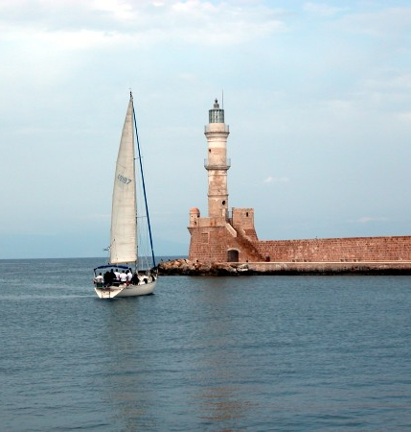
Implementing more effective creditor / agency partnerships can be the calm harbor in today’s storm
Segment accounts to identify needs
Provide consistency
Focus on core competencies
Share knowledge
Reduce operational costs
Improve liquidation rates
Notes:
Matthew

Slide 12
Value-based placements
Automate segmentation and placement strategies
Collection | Segment | Agency
Collection grade A | Highly collectable Highly contactable Regularly review to ensure grade and contactability | Short placement length Agencies must constantly prove themselves Test new partners
Collection grade B | Collectable Contactable Regularly review to ensure no migration of grade and / or contactability | Average placement length Proven agency, won’t skim accounts
Collection grade C | Less collectable Less contactable Closely watch for loss of contact | Average placement length Proven agency with special collection programs for these types of accounts
Specialty collection | State specific Legal process Low balance | Ability to manage your special requirements

Slide 13
Closing remarks
Name
© 20## Experian Information Solutions, Inc. All rights reserved.
Experian Public.
13

Slide 14

Questions
All participants
© 20## Experian Information Solutions, Inc. All rights reserved.
Experian Public.
14

Slide 15

© 2011 Experian Information Solutions, Inc. All rights reserved.
Experian Public.

